Slide 1
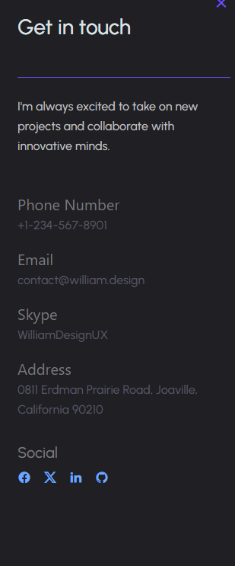
"I'm passionate about embracing new opportunities and working with innovative teams.“ +91 6393753995 mohdshuaib6393@gmail.com Remove skype Address: Lucknow India. Social: LinkedIn www.linkedin.com/in/mohd-shuaib-98b107267

Slide 2
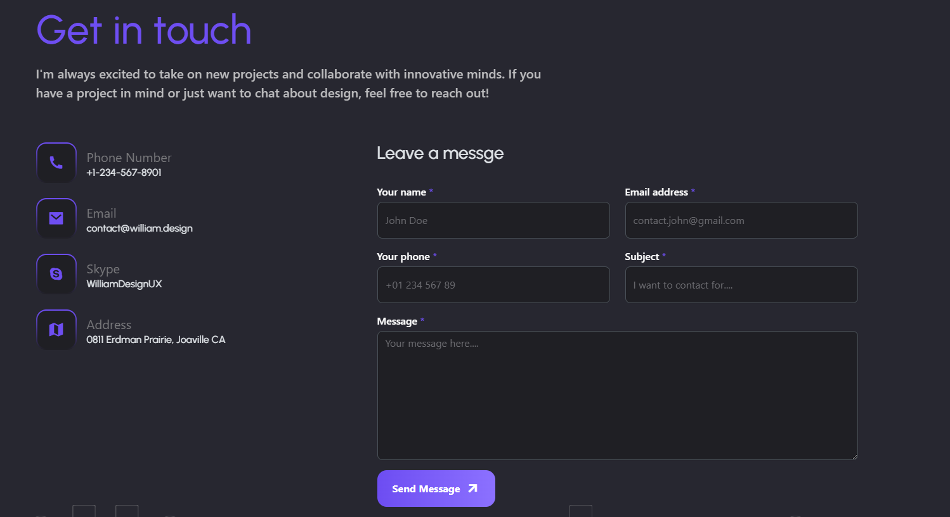
1.Remove Pricing 2. Remove Facebook, Twitter.
3. Add Instagram and LinkedIn
3. Remove William Design
4. By Clicking on contact add detials same as page 1

Slide 3

Add CV
https://drive.google.com/drive/folders/14B6uqhWYzF9ozfreEPz2ETwAwiaTmBuj?usp=sharing

Slide 4
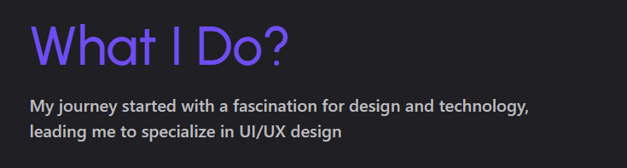
"My creative journey began with a love for visuals and layout, guiding me toward the world of graphic design."

Slide 5
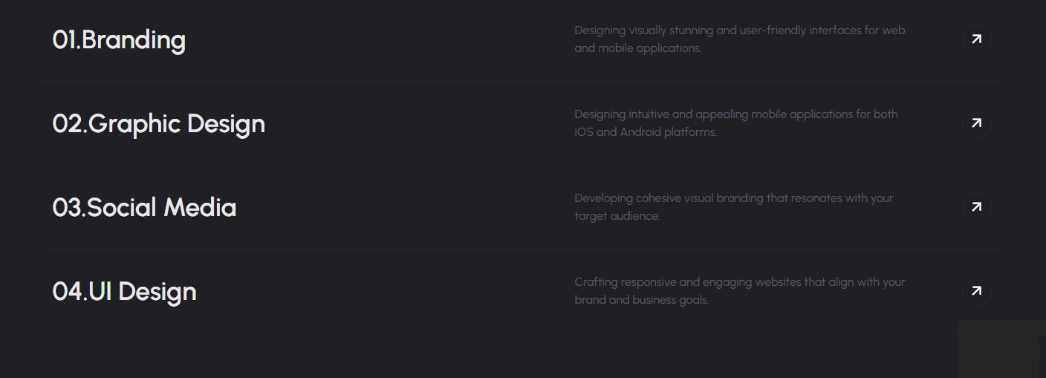
1. Branding
“My passion for design and visual identity led me to specialize in branding.“
2. Graphic Design
"My passion for creativity and visuals led me to specialize in graphic design.“
3. Social Media
"My interest in digital trends and visual communication led me to specialize in social media design.“
4.UI Design
"A love for intuitive and engaging digital experiences inspired me to pursue UI design."

Slide 6
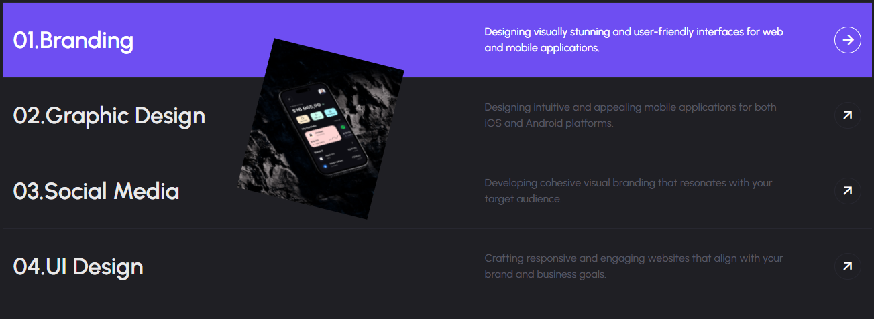
1. Branding
https://drive.google.com/file/d/1uARfms696emcRs40zBciphwBJZ1FHkqR/view?usp=sharing
2. Graphic Design
https://drive.google.com/file/d/1nWxmp9p1Er0yArXoBeJ6TFcxoUFn_9kx/view?usp=drive_link
3. Social Media
https://drive.google.com/file/d/1ugSUZehXJ754z5IqjXQNDDWvg-N40GWH/view?usp=drive_link
4.UI Design
https://drive.google.com/file/d/1WoJy8DpWPkYy1mPDBhXw9QxIgl0UZOTW/view?usp=drive_link

Slide 7

Cahnge Folder Name to
Dan Cates “Jungle Man”
Change photo to https://drive.google.com/drive/folders/1sxM8P1f9o5qs67zkQ6JgKgRGs5JpUUsS?usp=sharing

Slide 8


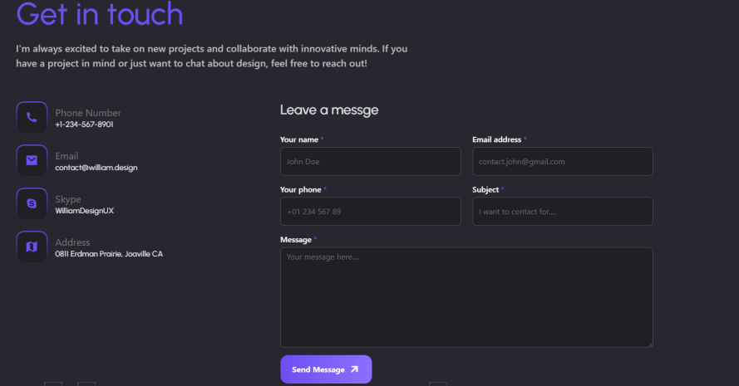
Remove all the Data and Add heading
Dan Cates “Jungle Man” in bold and Big
Correct Both like staring page 1

Slide 9

Change Group name to
In-house “Group M” Thumps Up Paris 2024 Campaign Edit
Change photo to
https://drive.google.com/file/d/1J_4npcT9KCt_833KxYNAkPzZG4MLOQBv/view?usp=sharing

Slide 10

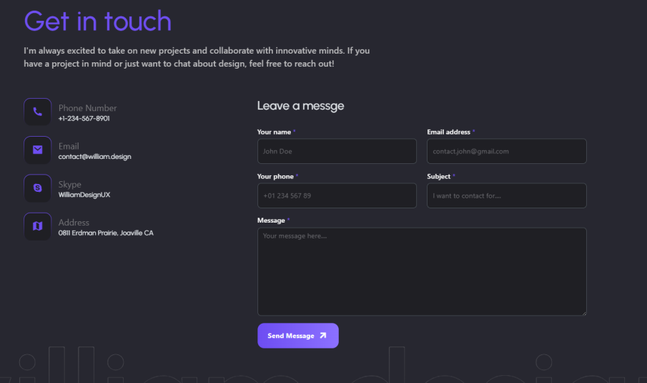
Change name to “Dan Cate “Jungle Man”
Video is not playing
Change all contact detials

Slide 11


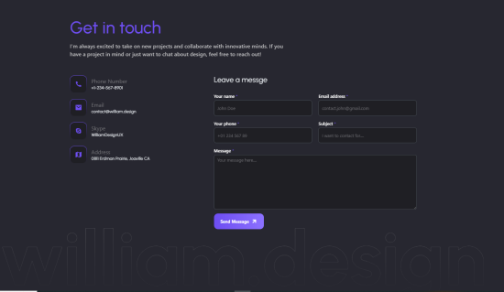
Change folder name to Campaign-”BIRLS X LULU EXCHANGE”
Change Folder Photo to
https://drive.google.com/file/d/1ZnNVYjROLSDD93syRMmIS467esiYEJsw/view?usp=sharing
Remove all and same name Campaign-”BIRLS X LULU EXCHANGE”

Slide 12
Change Description
Campaign Overview: Sell More, Win More
The “Sell More, Win More” campaign is an exciting and performance-driven initiative launched jointly by BILRS and LuLu Exchange, designed to motivate and reward the sales team for their outstanding efforts. Running for a duration of 100 days, from 15th April to 23rd July, this campaign aims to create a competitive yet engaging environment where top-performing staff members are recognized and rewarded for their dedication and results.
Objective of the Campaign
The core objective of this campaign is to:
Increase awareness and sales of BILRS services offered through LuLu Exchange outlets.
Encourage healthy competition among the sales staff to drive higher performance and improve customer engagement.
Reward top performers with exciting prizes, thus motivating consistent effort and enthusiasm throughout the campaign period.
Strengthen the collaboration between BILRS and LuLu Exchange by fostering a shared goal of service excellence and customer satisfaction.
Who Can Participate?
This campaign is likely targeted towards:
Frontline staff at LuLu Exchange branches who are responsible for selling BILRS products or services.
Sales executives, agents, or customer service teams who directly interact with customers and contribute to increasing transaction volumes or service subscriptions.
How It Works
Participants are encouraged to sell more BILRS services — whether that includes international bill payments, recharges, or other digital financial services.
Performance is tracked throughout the 100-day campaign period.
The more you sell, the higher your chances of winning — hence the campaign name, “Sell More, Win More.”
Winners are selected based on their overall contribution, sales volume, or specific milestones reached during the campaign.
Exciting Rewards Await!
To make the campaign more thrilling and competitive, a wide range of attractive prizes are up for grabs, including:
Smartphones – High-end mobile phones for top achievers.
Smartwatches – For those who are not just smart in sales, but stylish too.
LED TVs – To add more entertainment to your home.
Cash Rewards – Because everyone loves a little extra in their wallet.
These rewards are a token of appreciation for the consistent effort and excellent sales performance shown by individuals during the campaign.
Why This Campaign Matters
It creates a motivational push for employees to go the extra mile.
It helps enhance customer interactions, as motivated staff are more likely to communicate better and offer valuable information to customers.
It fosters a culture of achievement and recognition, making employees feel valued and appreciated.
It aligns the goals of both BILRS and LuLu Exchange to boost service usage and increase brand visibility.
Campaign Slogan:
“Sell More, Win More” – Simple, powerful, and inspiring. The slogan reinforces the idea that consistent performance and dedication will lead to tangible, exciting rewards.
Call to Action
The campaign boldly invites all eligible participants to:
“Start Participating Today!”
This call to action encourages immediate engagement and sets the tone for a dynamic 100-day journey of sales, excitement, and rewards.
Terms & Conditions
As with all incentive-based programs, the campaign is subject to terms and conditions, which may include:
Minimum sales targets to qualify for prizes.
Verification and reporting procedures.
Fair play policies to ensure transparency and equal opportunity for all participants.
Conclusion
The “Sell More, Win More” campaign is more than just a reward program – it’s a celebration of hard work, commitment, and success. By recognizing and rewarding top performers, BILRS and LuLu Exchange not only boost their business goals but also create a motivating workplace culture where employees feel driven, competitive, and appreciated. With great prizes on the line and a clear goal ahead, the next 100 days promise to be full of energy, teamwork, and winning moments.

Slide 13
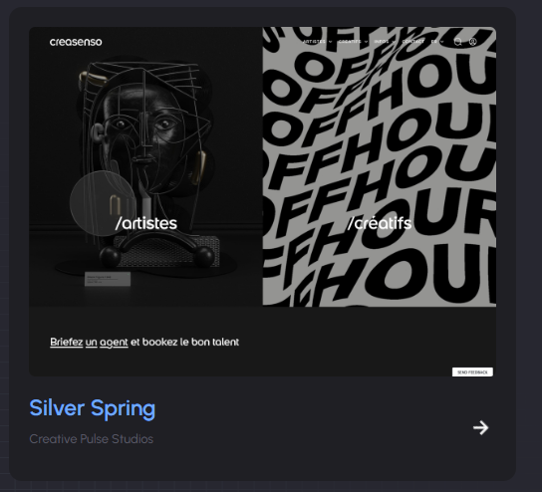

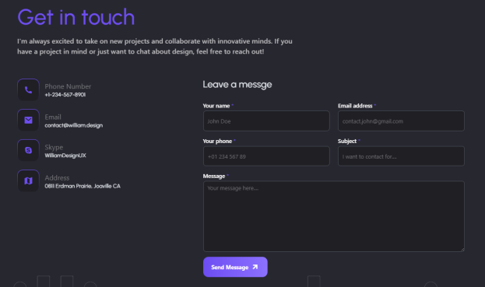
Change folder name to Branding –Silver Spring
Change Folder Photo to
https://drive.google.com/file/d/13yhOfvaAQq2I7tXWfMHOA_7IvhsTtT00/view?usp=sharing
Change name here also

Slide 14
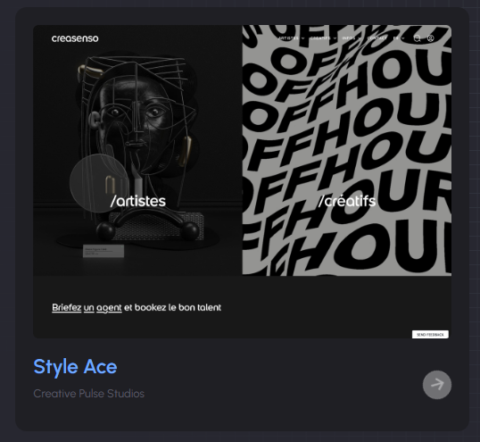

Change folder name to Branding –Style Ace
Change Folder Photo to
https://drive.google.com/file/d/13yhOfvaAQq2I7tXWfMHOA_7IvhsTtT00/view?usp=sharing
Change Name Here to
Put the video in the last

